Slide 1
Installing MDT in Eclipse
Adrian.Pop@liu.se

Slide 2
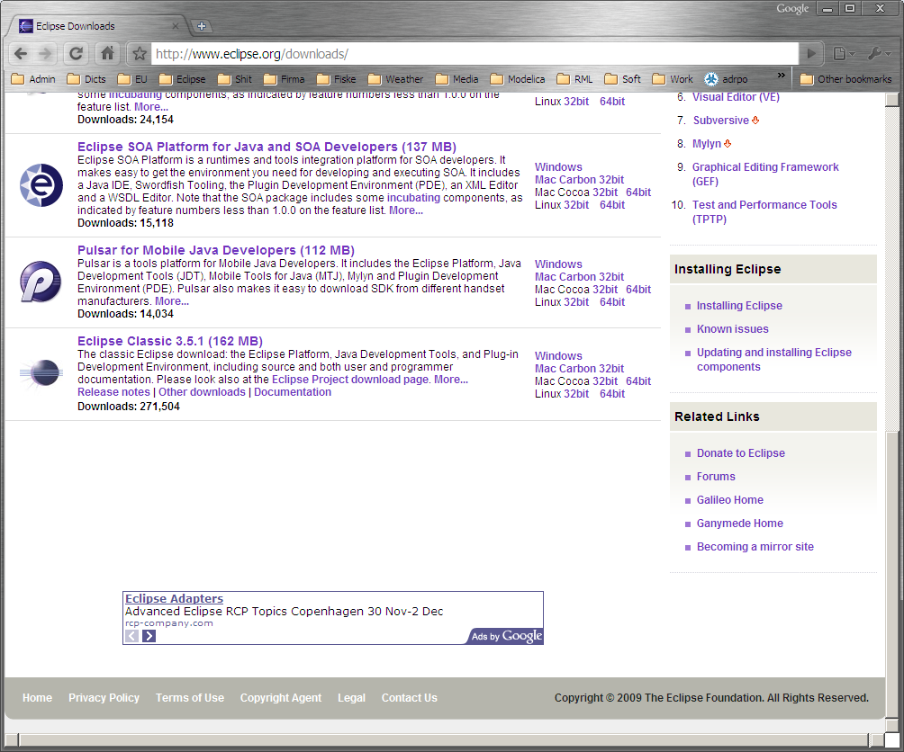
Download Eclipse Classic 3.5.1

Slide 3
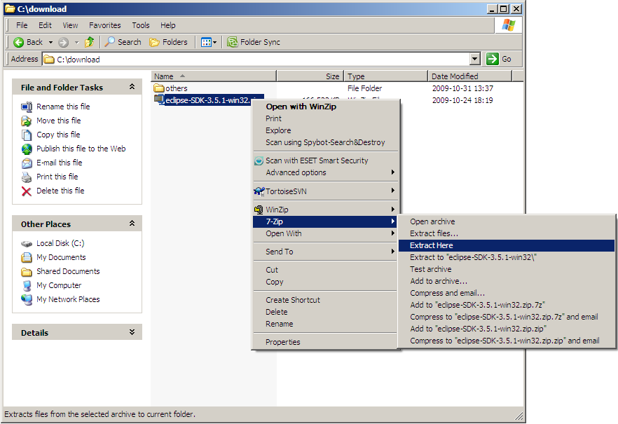
Install Eclipse by unpacking the .zip

Slide 4
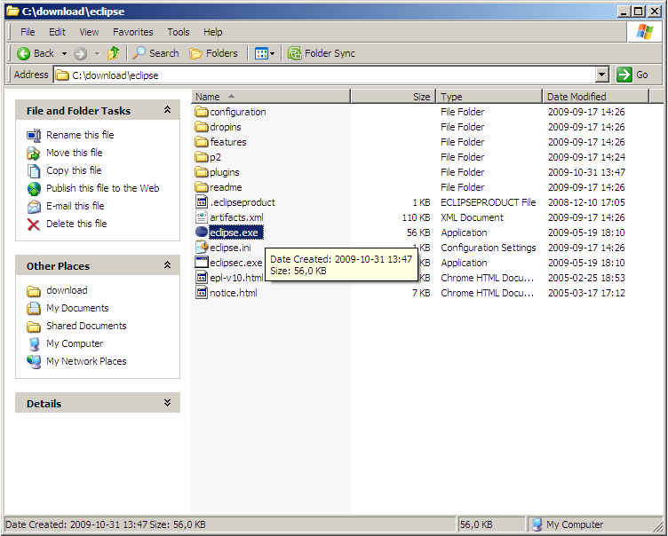
Start Eclipse

Slide 5
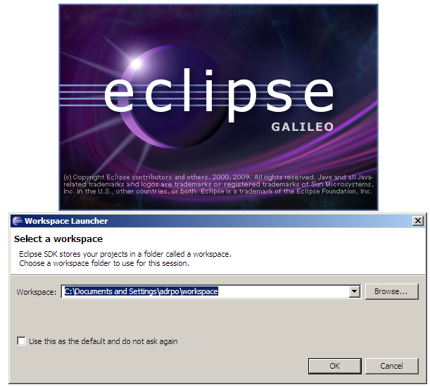
Choose an Eclipse Workspace

Slide 6
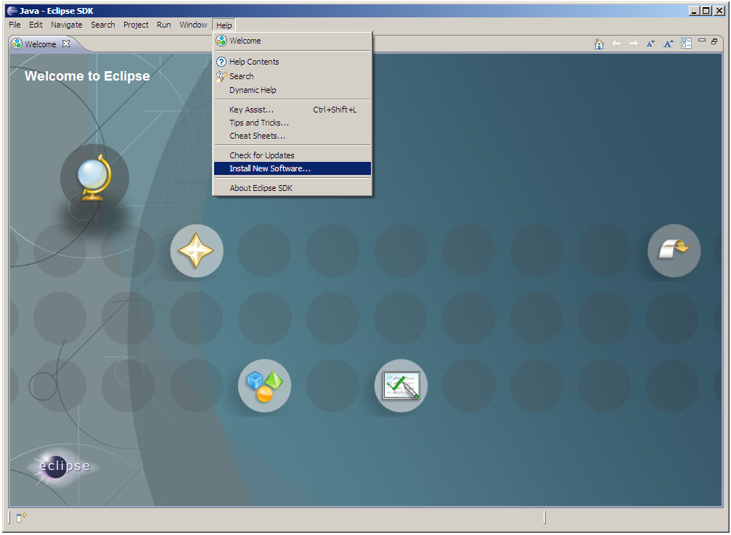
Eclipse - Help->Install New Software...

Slide 7
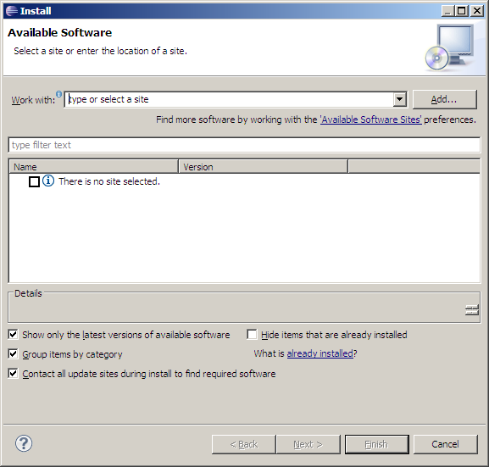
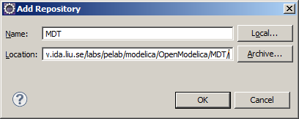
Eclipse - Install New Software
click on Add
Enter Name: MDT and Location: http://www.ida.liu.se/labs/pelab/modelica/OpenModelica/MDT

Slide 8
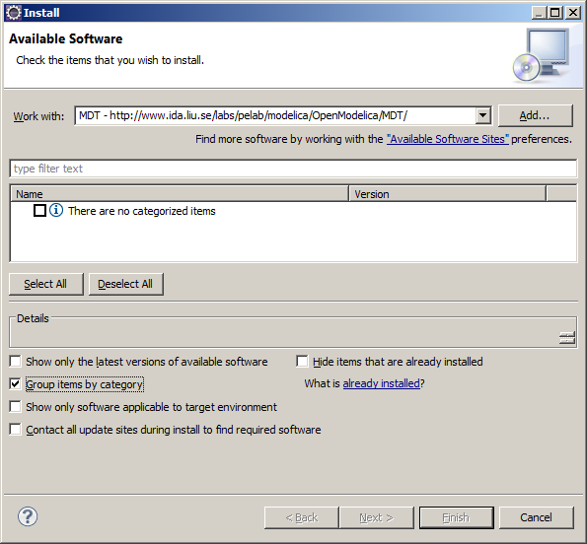
Eclipse – Important Step
By default no MDT is shown!
Un-Check:
Group items by category

Slide 9
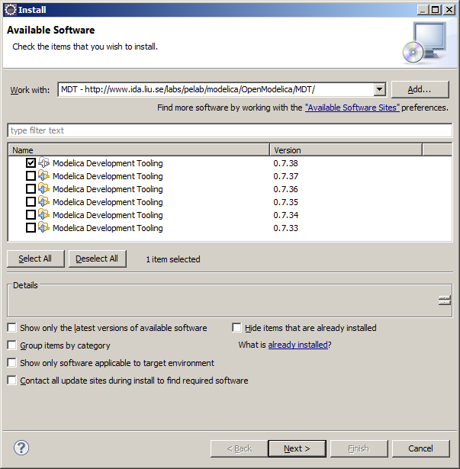
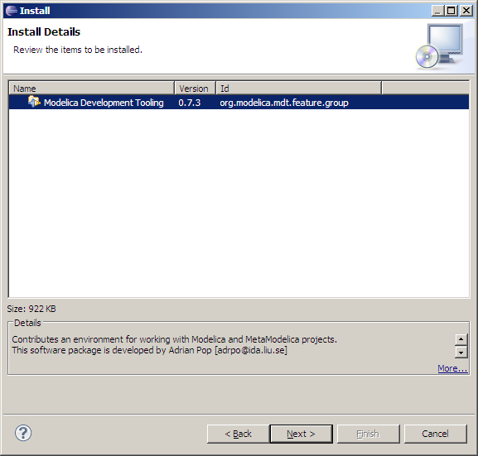
Eclipse - Select MDT 0.7.3

Slide 10
Eclipse - MDT
Click:
Next->Next->(accept the license)
Finish
Accept not signed content
Say yes at restart

Slide 11
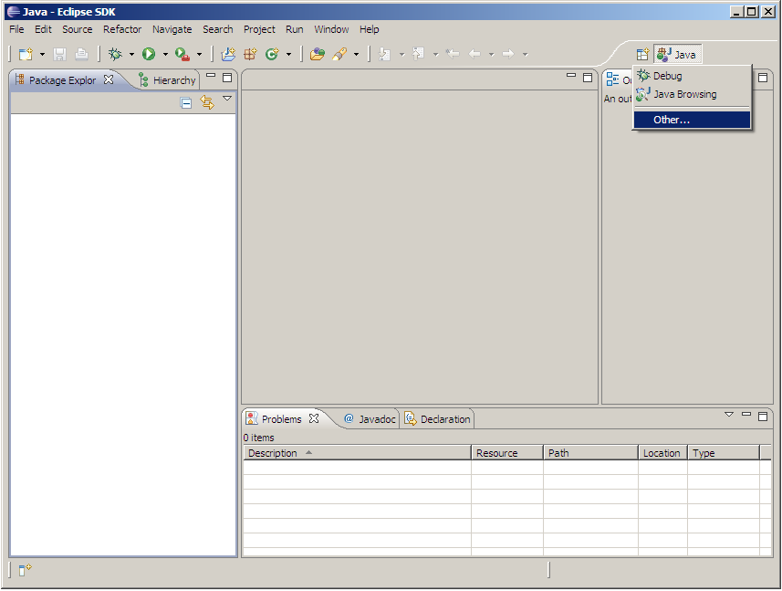
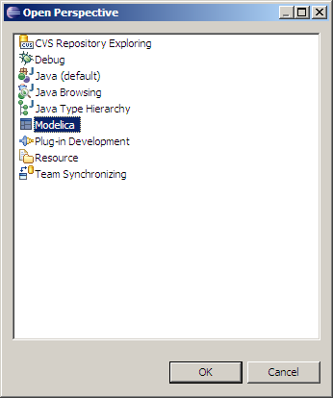
Eclipse – Activate Modelica Perspective

Slide 12
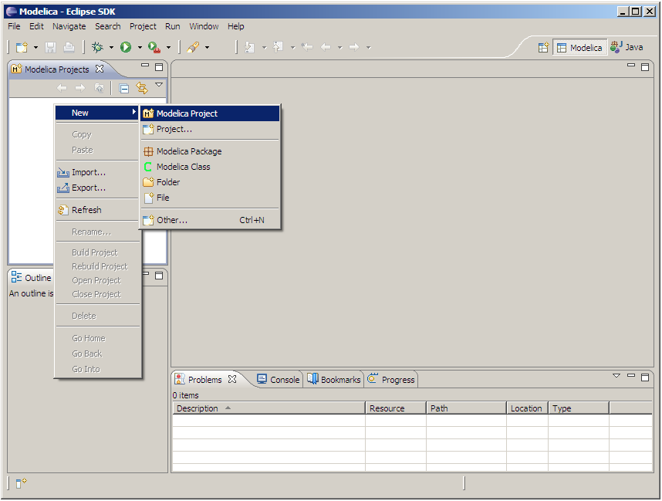
Eclipse – Modelica Perspective
Right click
in the
Projects
area

Slide 13
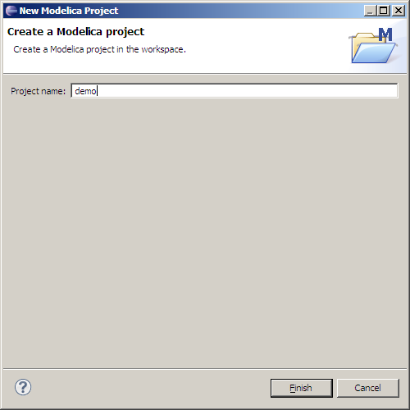
Eclipse – New Modelica Project
Right click in the
Projects area

Slide 14
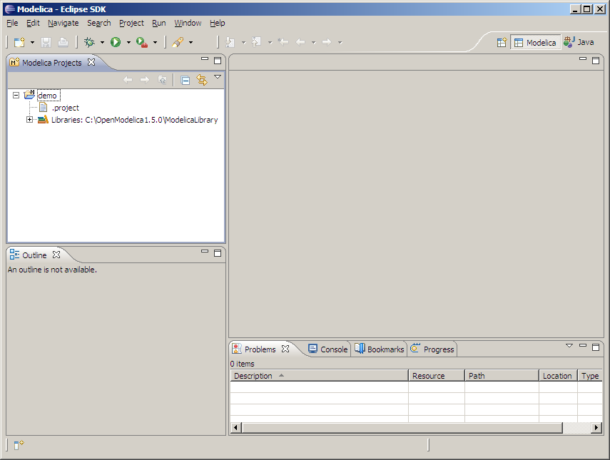
Eclipse – First Modelica Project

Slide 15
The End
https://www.OpenModelica.org

